Slide 1


PROJECT
CSCE 2203
Analysis and Design of Algorithms Lab
|
Go
Building a Search Engine

Slide 2
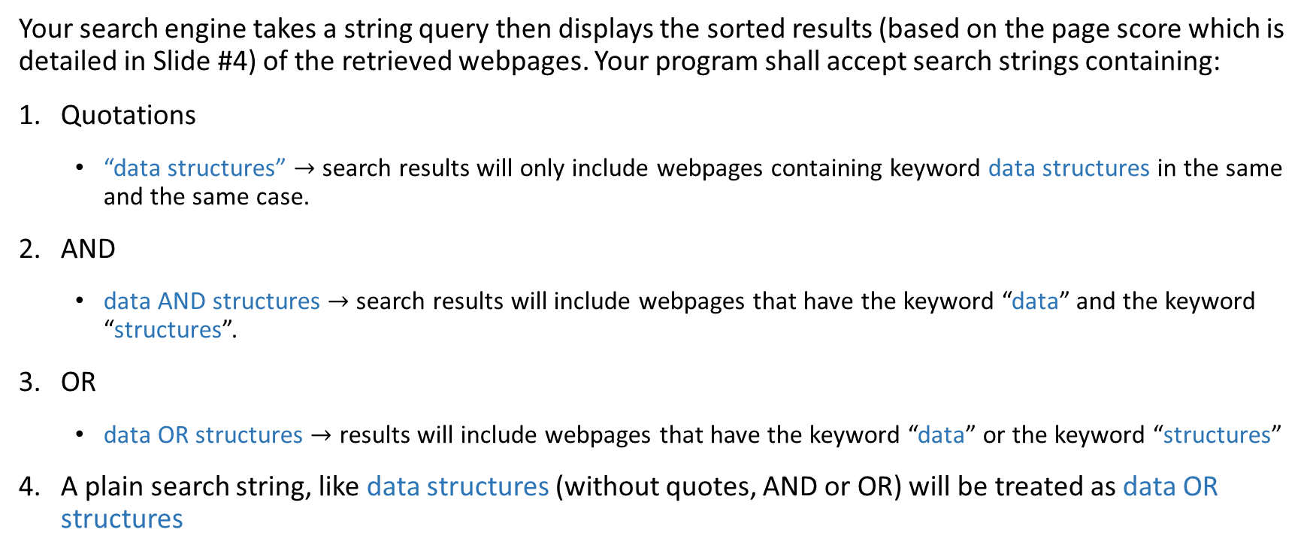
Search Query

Slide 3
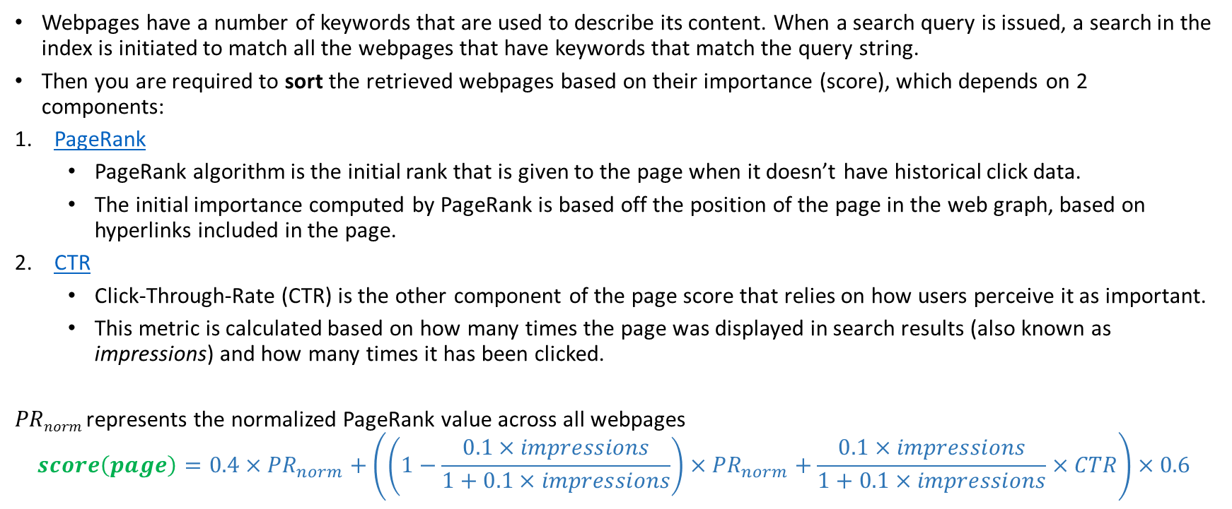
Ranking Webpages
PageRank video:
https://www.youtube.com/watch?v=P8Kt6Abq_rM
CTR
https://en.wikipedia.org/wiki/Click-through_rate
Part of the project is to research both. As a starting point, click on the links above.

Slide 4
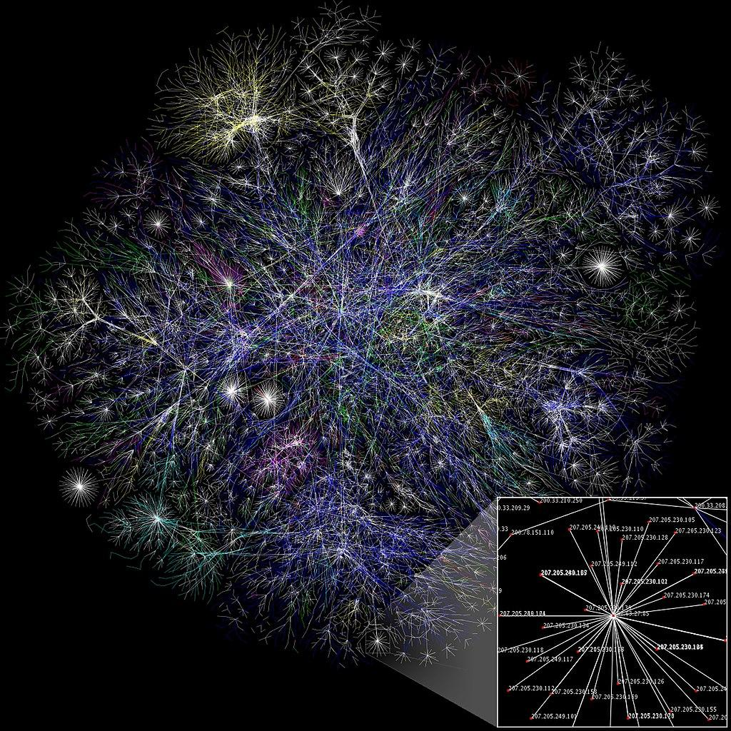
Web Graph
A web graph is a directed graph, whose vertices correspond to webpages, and a directed edge connects page X to page Y if there exists a hyperlink on page X, referring to page Y.
(Wikipedia) Partial map of the Internet in January 15, 2005

Slide 5
Program Initialization
Your program initialization should accept 3 input files:
Web graph file (in CSV format). Each line in the input file would have two URLs showing a link from the first page to the second page. Sample web graph Initialization file:
Keyword file (in CSV format), which contains the list of keywords for each webpage. Sample keyword initialization file:
Number of impressions file (in CSV format), which contains the initial number of times each webpage appeared in the search results (needed to compute CTR). Sample impressions initialization file:
www.website1.com,www. website2.com www.website2.com, www.website3.com www. website3.com,www. website4.com www. website1.com,www. website3.com
www.website1.com,aalgorithms,greedy,complexity www.website2.com, machine,learning, deep learning www.website3.com,programming,complexity,space, bruteforce
www.website4.com,programming,java,python,objects
www.website1.com,10 www.website2.com,45 www.website3.com,101 www.website4.com,20

Slide 6
Update Number of Clicks
After your program displays the search results (list of relevant webpages sorted by score), the CTR for each webpage must be updated:
Your program shall update the number of impressions for the webpages that appeared in the results list. This updates the 1st component of CTR.
Your program shall allow the user to choose which webpage (among the results list) to open. This updates the 2nd component of CTR.
Note: The updated values must be saved onto a file and loaded when the program starts. This way, updates won’t be lost when the program ends.

Slide 7
Program Menus
When your program is initially started, you shall allow the user to either perform a search or exit the program.
If the user chooses to search, a numbered results list (sorted by webpage score) shall appear to him/her, then he/she shall be allowed to:
Open a webpage among the result by typing in it’s number on the list
Perform a new search
Exit the program
If the user chooses to open a webpage, you shall allow him/her to:
Return to the results list and open a new webpage
Perform a new search
Exit the program

Slide 8
What to Submit
Your submission must include
Source code (.cpp files)
An executable (.exe) file to run the engine
A report including:
The pseudo-code for your indexing and ranking algorithms
A time and space complexity analysis for your indexing and ranking algorithms
The main data structures used by your algorithm
Any design tradeoffs you made along with their justifications

Slide 9
Project Logistics
The project carries 30% of the course’s grade.
The deadline for submitting the project is 1st May 2023 10:00 PM.
Please submit your work on time because no late submissions will be accepted.
This is an individual project.
AUC’s Academic Integrity guidelines will be strictly enforced.

Slide 10
Project Rubric
Source code [22.5 Points = 75%]
1. PageRank [5 points]
2. CTR [3 points]
3. Overall score [2 points]
4. Updating score of all pages in files [5 points]
5. Search query (AND, OR, quotations) [4 points]
6. Program menus [2.5 points]
7.An executable (.exe) file to run the engine [1 points]
Report [7.5 Points = 25%]
1. The pseudo-code for your indexing and ranking algorithms [2 points]
2. A time and space complexity analysis for your indexing and ranking algorithms [2 points]
3. The main data structures used by your algorithm [2.5 points]
4. Any design tradeoffs you made along with their justifications [1 point]
Good luck!

